Slide 1

Project Title
Haneedy – E-commerce Website for Handmade Products
Presenter’s Name:
Eng Mahmoud Ibrahim Elsayed
Date:
29 Nov 2025

Slide 2
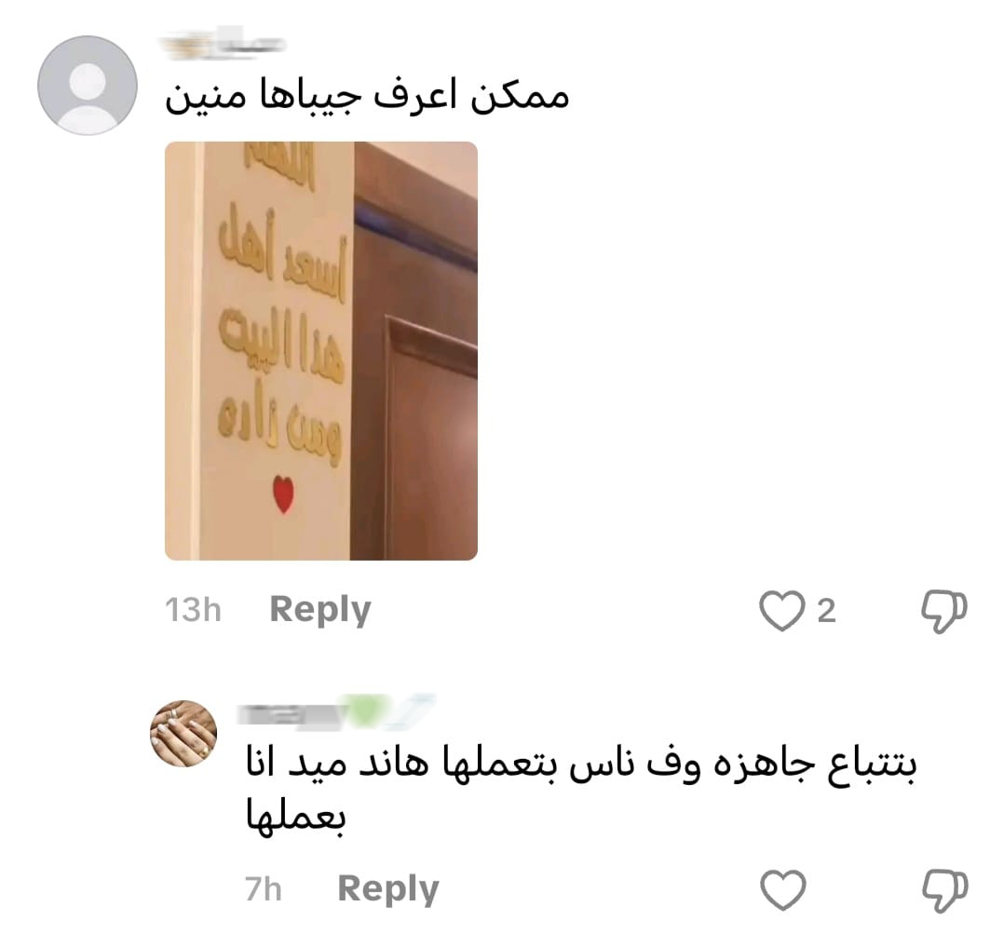

Problem: Many local Egyptian artisans struggle to sell their handmade products online due to limited visibility and lack of a dedicated e-commerce platform. Solution: Haneedy is an e-commerce platform designed to help local artisans showcase and sell their handmade products in a simple and easy-to-use interface. Unique Value Proposition: Haneedy focuses exclusively on Egyptian handmade products, providing a secure and user-friendly platform that connects artisans directly with customers.

Slide 3
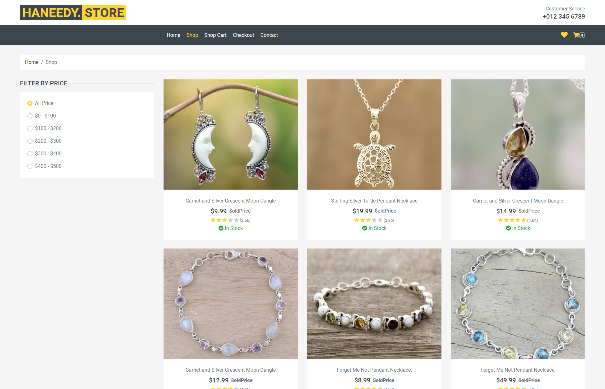
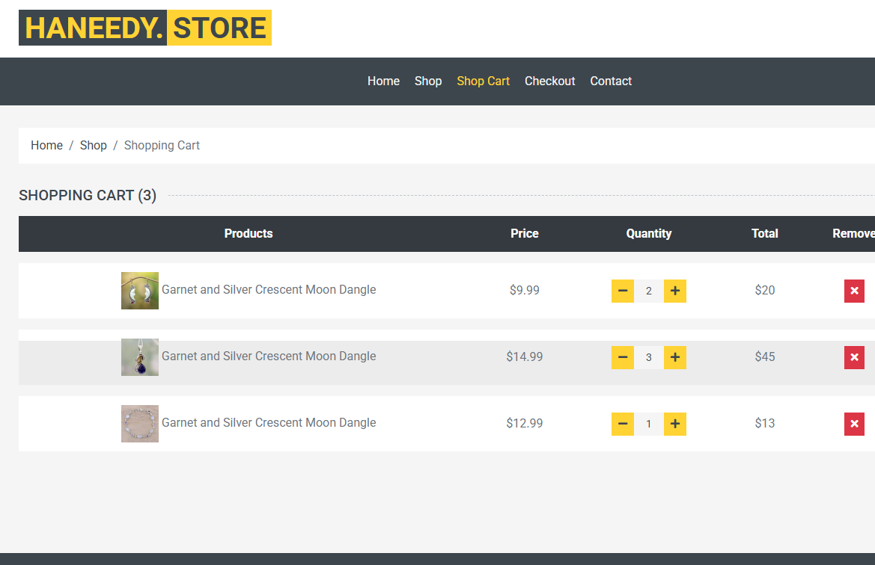
Shop Page
Shop Cart
-User Journey Overview:
Users start from the homepage and browse available handmade products.
They can view product details and add desired items to the shopping cart.
Once ready, users proceed to the checkout page to enter billing information and confirm the order.
The system ensures a smooth and intuitive shopping experience.
-Focus on Usability and User Experience:
Clean and simple interface for easy navigation.
Quick access to the cart and checkout for a seamless shopping experience.
Designed to be responsive and user-friendly on both desktop and mobile devices.

Slide 4



Test
End Users:
Individuals: Customers who want to easily browse and purchase handmade products.
Artisans: Local artisans who submit their products through admin approval; they do not manage their own profiles or display products directly.
Key Features:
Product Browsing & Search: Users can explore products and filter by price.
Shopping Cart & Order Adjustment: Customers can adjust product quantities before placing an order.
Artisan Profiles: Each artisan has a personal profile to view their submitted products and ratings.
How Features Solve User Problems:
Browsing & Search: Helps customers quickly find products they want.
Shopping Cart & Order Adjustment: Simplifies the buying process and allows users to modify orders before checkout.
Admin-mediated Artisan Submission: Ensures products are approved and correctly listed without artisans handling the platform directly.
Test

Slide 5

Data Structure Database Architecture: We used a local JSON file to simulate a database, serving as our data source for products, users, and orders. This acts as a lightweight, non-relational data storage for the project. Key Entities and Relationships: Main entities include Products, Users, and Orders. Products are linked to users via order submissions; users can browse products and adjust their orders before checkout. Data Flow: Data is stored in JSON files, accessed via a local API. The frontend fetches data from this API, allowing users to view products, update quantities, and submit orders. All data is temporarily stored in memory during runtime.

Slide 6
Programming Languages: JavaScript, HTML5, CSS3 Frontend Framework/Library: React.js Backend / API: Local JSON file as data source (simulating backend)
Programming
Languages
& Frameworks
Supporting
Technologies
GitHub (version control) Netlify / Vercel (deployment) Figma / Photoshop (UI/UX design)

Slide 7
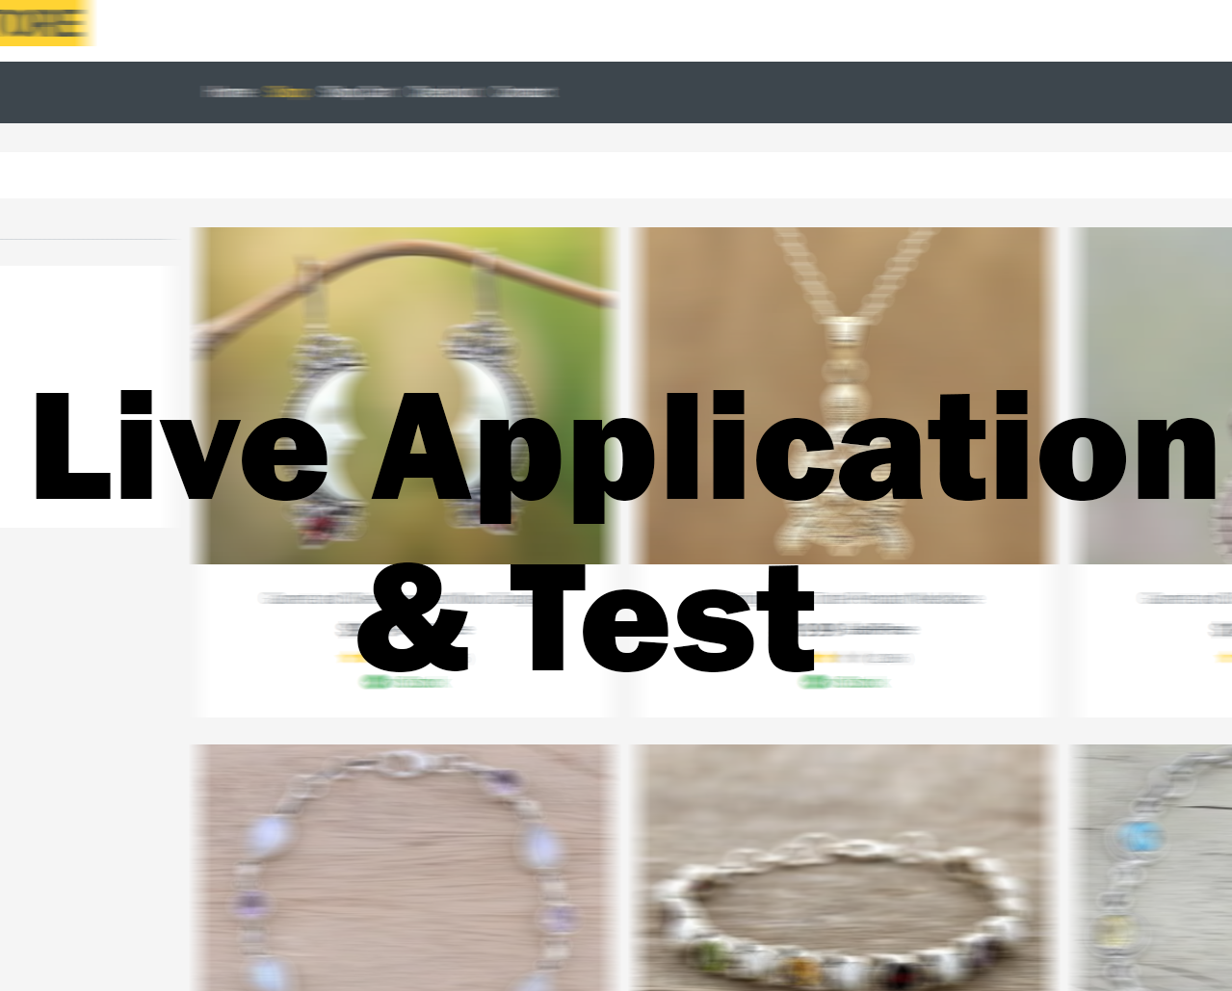
Current State: Application is currently in beta. Core features are functional and accessible to users. Testing Phases: Unit Testing: Verified individual components for correctness. Integration Testing: Ensured modules work together seamlessly. User Testing: Feedback collected from team members. User & QA Feedback: Feedback received from Eng Mohamed Emad, and Hashem. Positive comments on navigation and design. Minor bugs identified and fixed. Suggestions for feature improvements recorded for next update.

Slide 8

Haneedy – E-commerce Website
for Handmade Products
Milestone | Description | Deadline
UI Design Completion | Finalize UI/UX design for all pages (Home, etc) | 15 Oct 2025
Frontend Development – Phase 1 | Develop core pages(Welcome, Home, Shop, etc) | 20 Oct 2025
Frontend Development – Phase 2 | Create and connect backend APIs for all features | 15 Nov 2025
API Creation & Integration | Test all features, fix bugs, ensure full functionality | 28 Nov 2025
Final Deployment & Presentation Prep | Deploy project, prepare slides and presentation | 29 Nov 2025

Slide 9
Haneedy – E-commerce Website
for Handmade Products
Student Name | Student ID | Roles
Mahmoud Ibrahim Elsayed Sobhi | 21042972 | Shop, Fav Pages & UI/ UX Design
Mohamed Gomaa Elshahat Metwally | 21107743 | Home, Contact Pages
Hashim Elsayed Hashim Eltilaty | 21018454 | Components (Navbar, Footer..)
Mohamed Emad AbdAlazeam Ali | 21071961 | Cart, Single Product Pages & API
Mohamed Ali El Sayed Ali | 21034488 | Checkout Page
Mohamed Mahmoud Esmail Gohary | 21064008 | Fav Page

Slide 10

Contact Information
Email: mahmoudafx1@gmail.com
Phone: +20 10 609 72925
GitHub : github.com/mahmoudafx1
Questions & Feedback
Feel free to ask any questions or share your feedback!

